Slide 1
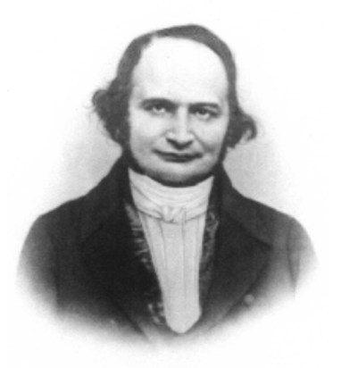
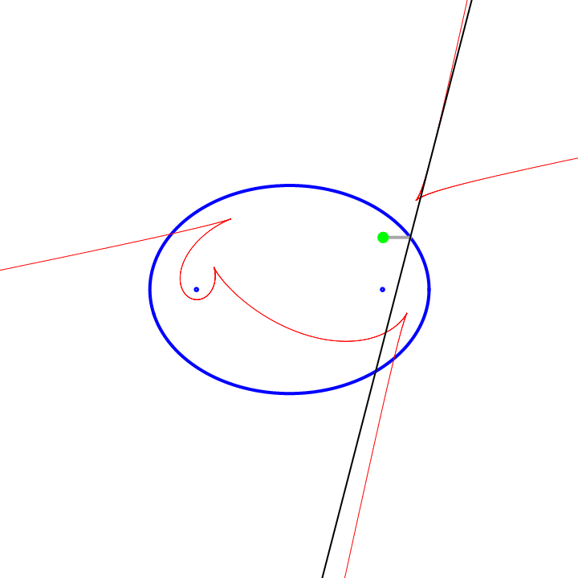
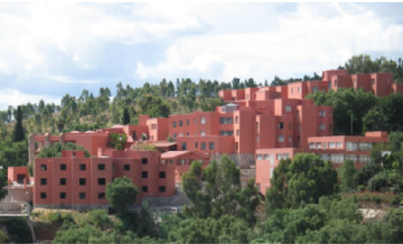
Cusps of caustics by reflection
in a convex billiard table
Gil Bor (CIMAT, Guanajuato, Mexico)
joint with Sergei Tabachnikov (Penn State)
Am. Math. Monthly (21 March, 2023, online)
https://arxiv.org/abs/2112.07852
Toulouse, Sept 14, 2023

Slide 2
Caustic is the envelope of a 1-parameter family of lines (‘light rays’).
by reflection
by refraction

Slide 3
Nephroide

Slide 4
The 1st three caustics by reflection in a convex table (cusps not shown)

Slide 5
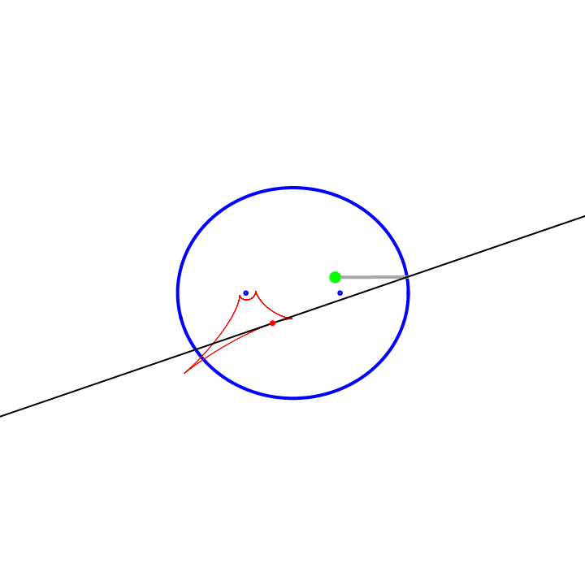
The 1st caustic by reflection in an elliptical table
(4 cusps)

Slide 6
The 1st caustic by reflection in an elliptical table
(4 cusps)

Slide 7
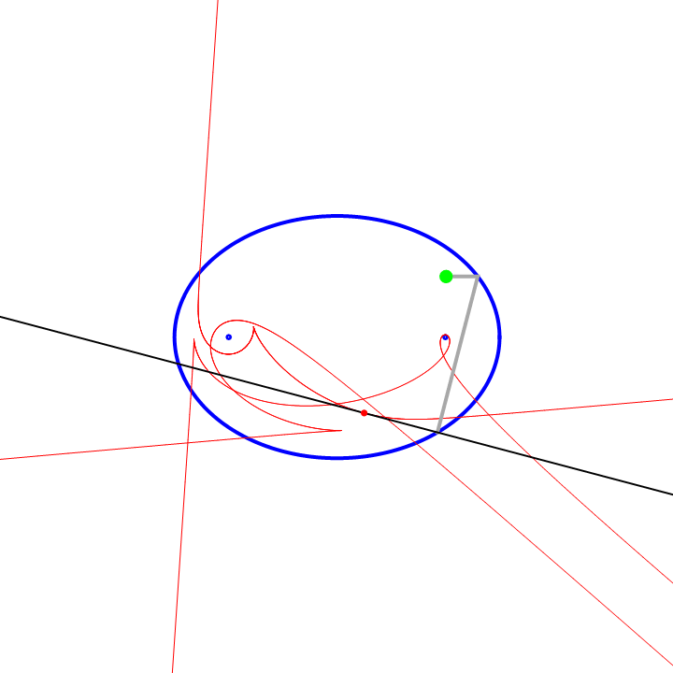
The 2nd caustic by reflection in an elliptical table
(4 cusps)

Slide 8
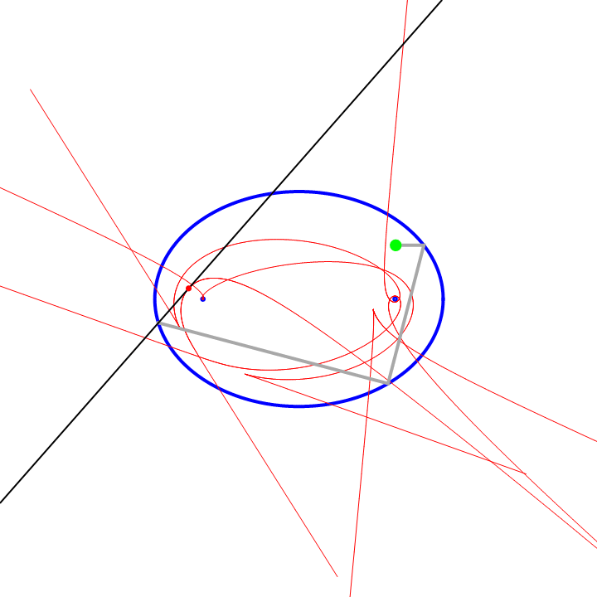
The 3rd caustic by reflection in an elliptical table
(4 cusps)

Slide 9
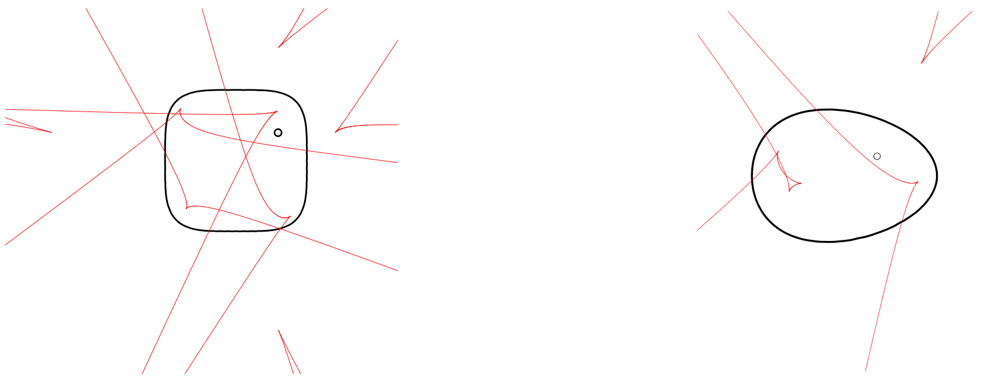
The 1st caustic by reflection in a non-elliptical table
(> 4 cusps)

Slide 10
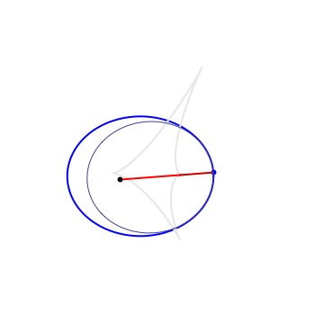
1st caustic by reflection (catacaustic): the locus of 2nd foci of osculating Kepler conics, via a string construction

Slide 11
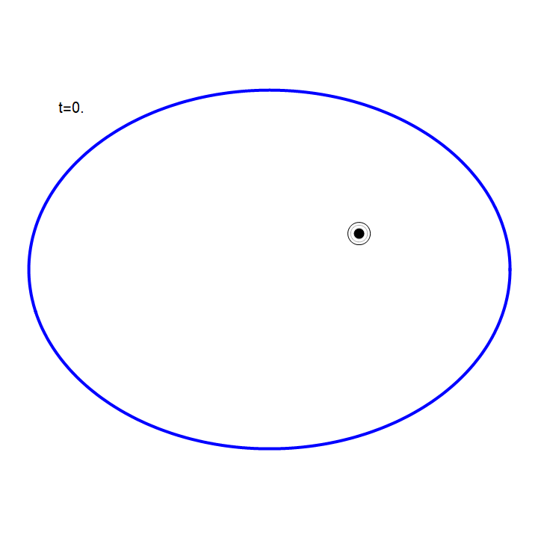
wave fronts in elliptical pool.

Slide 12
Theorem: for every oval (strictly convex compact table), a generic light source in its interior and $n≥1,$ the $n$-th caustic by reflection has $≥4$ cusps.

Slide 13
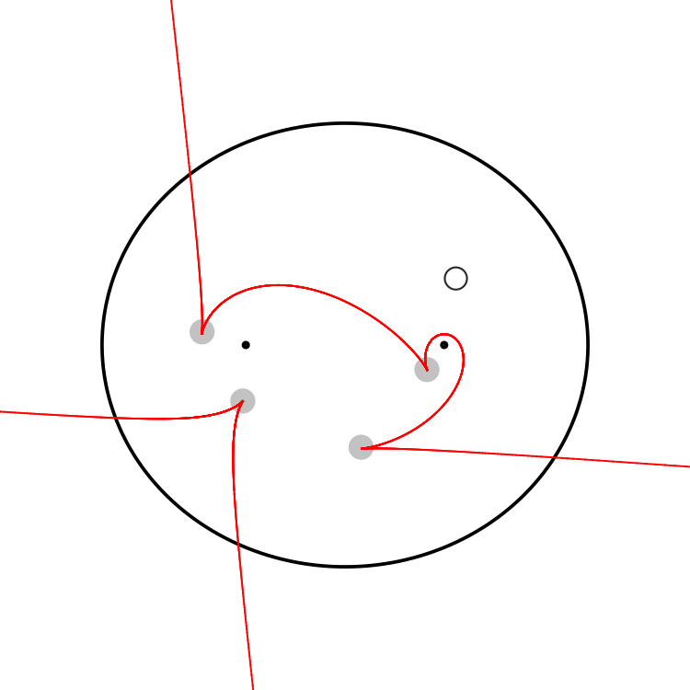
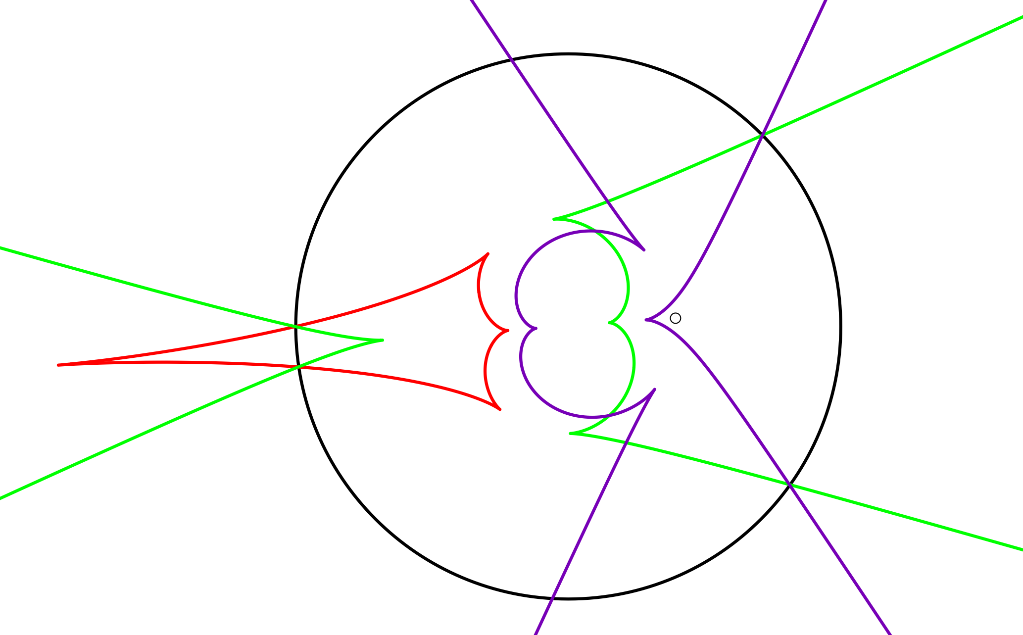
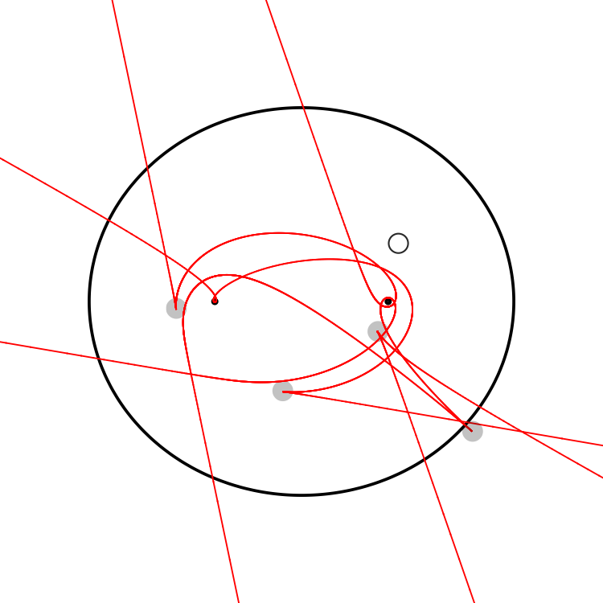
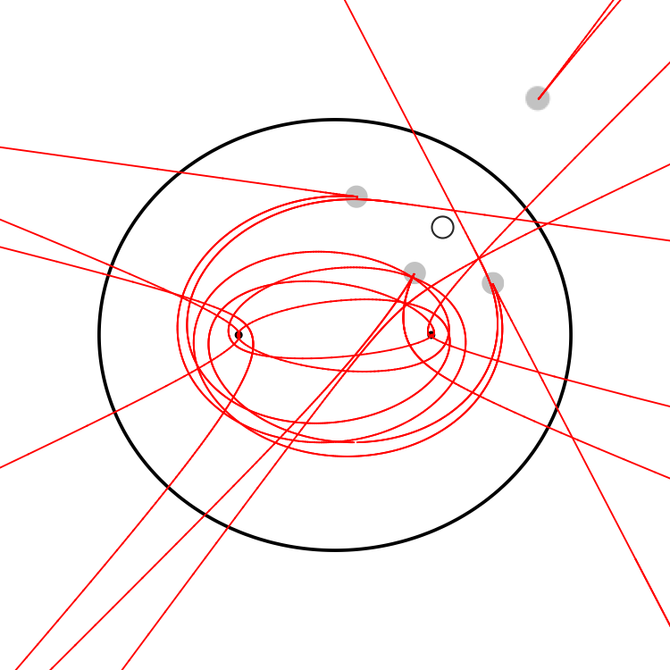
n=1,2,3
n=2
n=5
n=8
Conjecture: there are 4 cusps (exactly) iff the billard table is an ellipse

Slide 14
Motivation 1
Jacobi’s “Last Geometric Statement” (1843): the conjugate locus of a non-umbilical point of an ellipsoid has exactly four cusps.
Generalization
The n-th conjugate locus of a generic point on a convex surface has at least 4 cusps; exactly 4 for an ellipsoid.

Slide 15
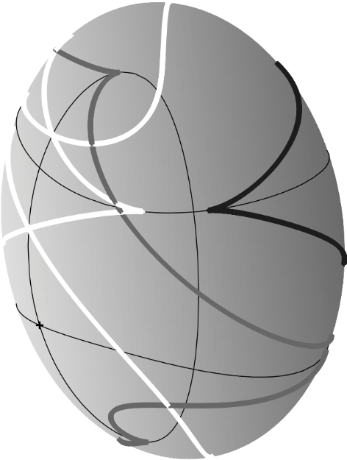
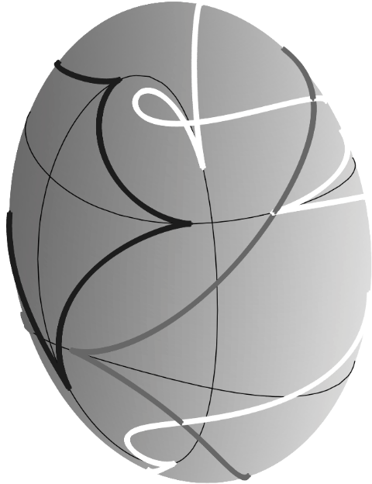
Jacobi’s “Last Geometric Statement” proved for
1st caustic, ellipsoid, 4 cusps: Itoh & Kiyohara (2004)
1st caustic, convex surfaces, $≥4$ cusps: Caratheodory (1912), Waters (2019)
n > 1 caustics : open (experiments, R Sinclair)
1st caustic (black) 2nd (grey) and 3rd (white), from a pt on a triaxial ellipsoid

Slide 18
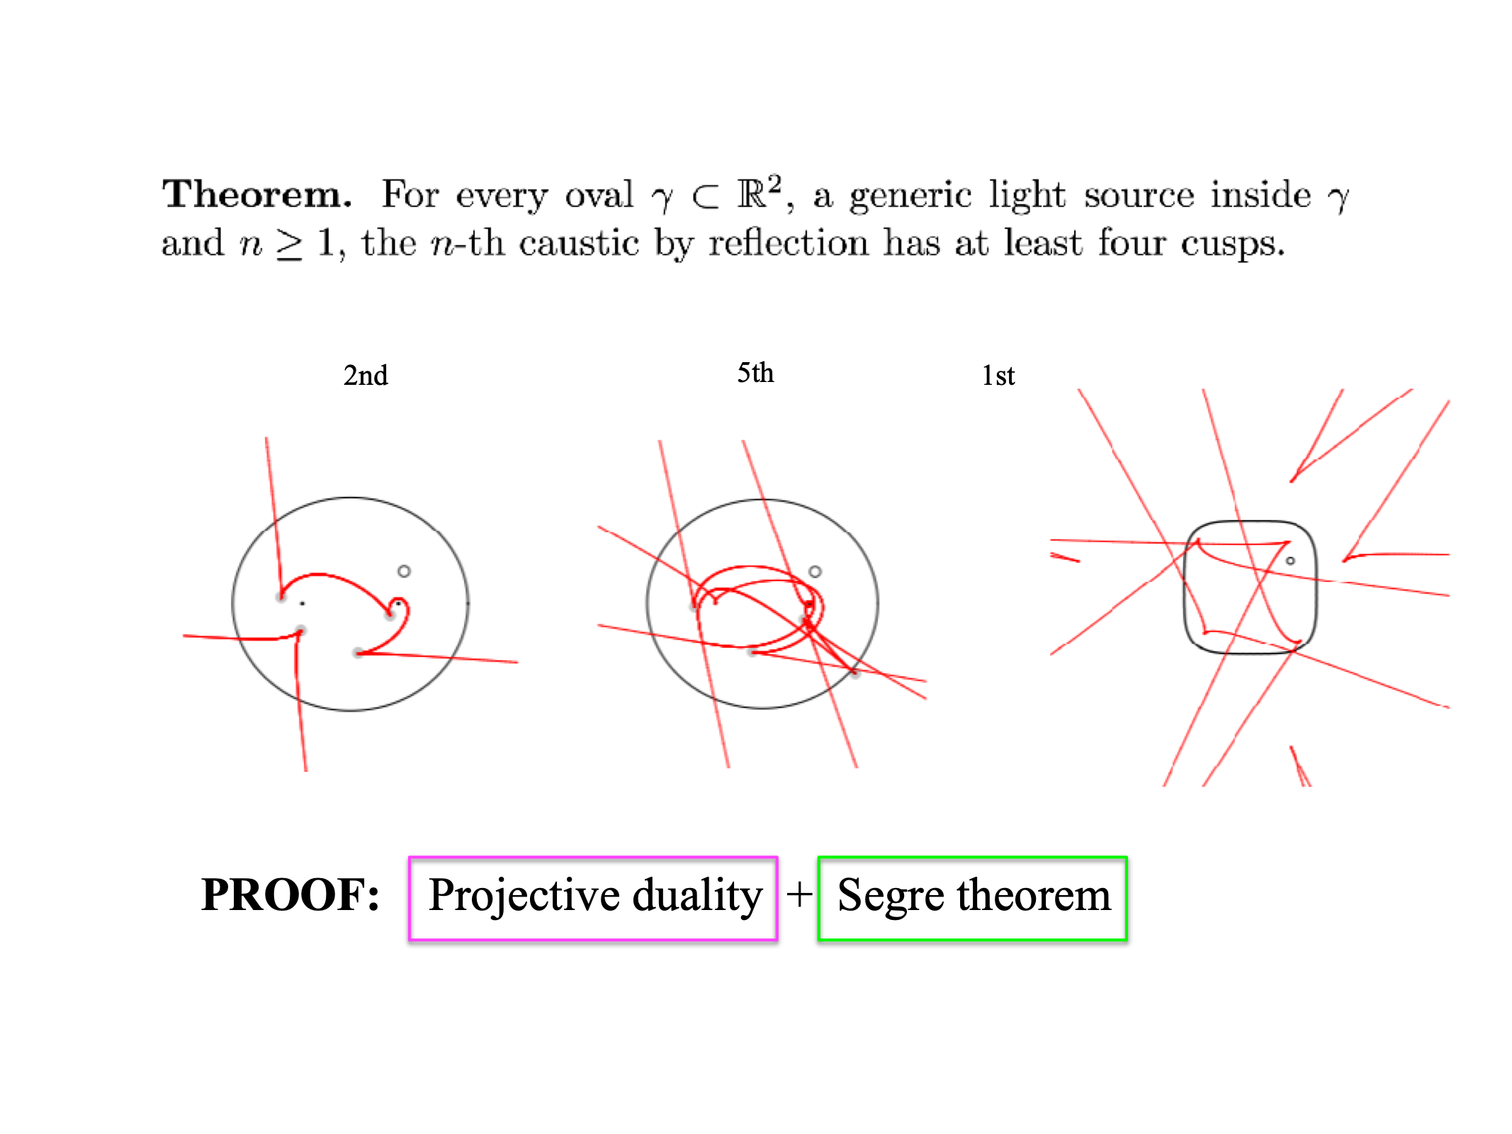

Slide 20
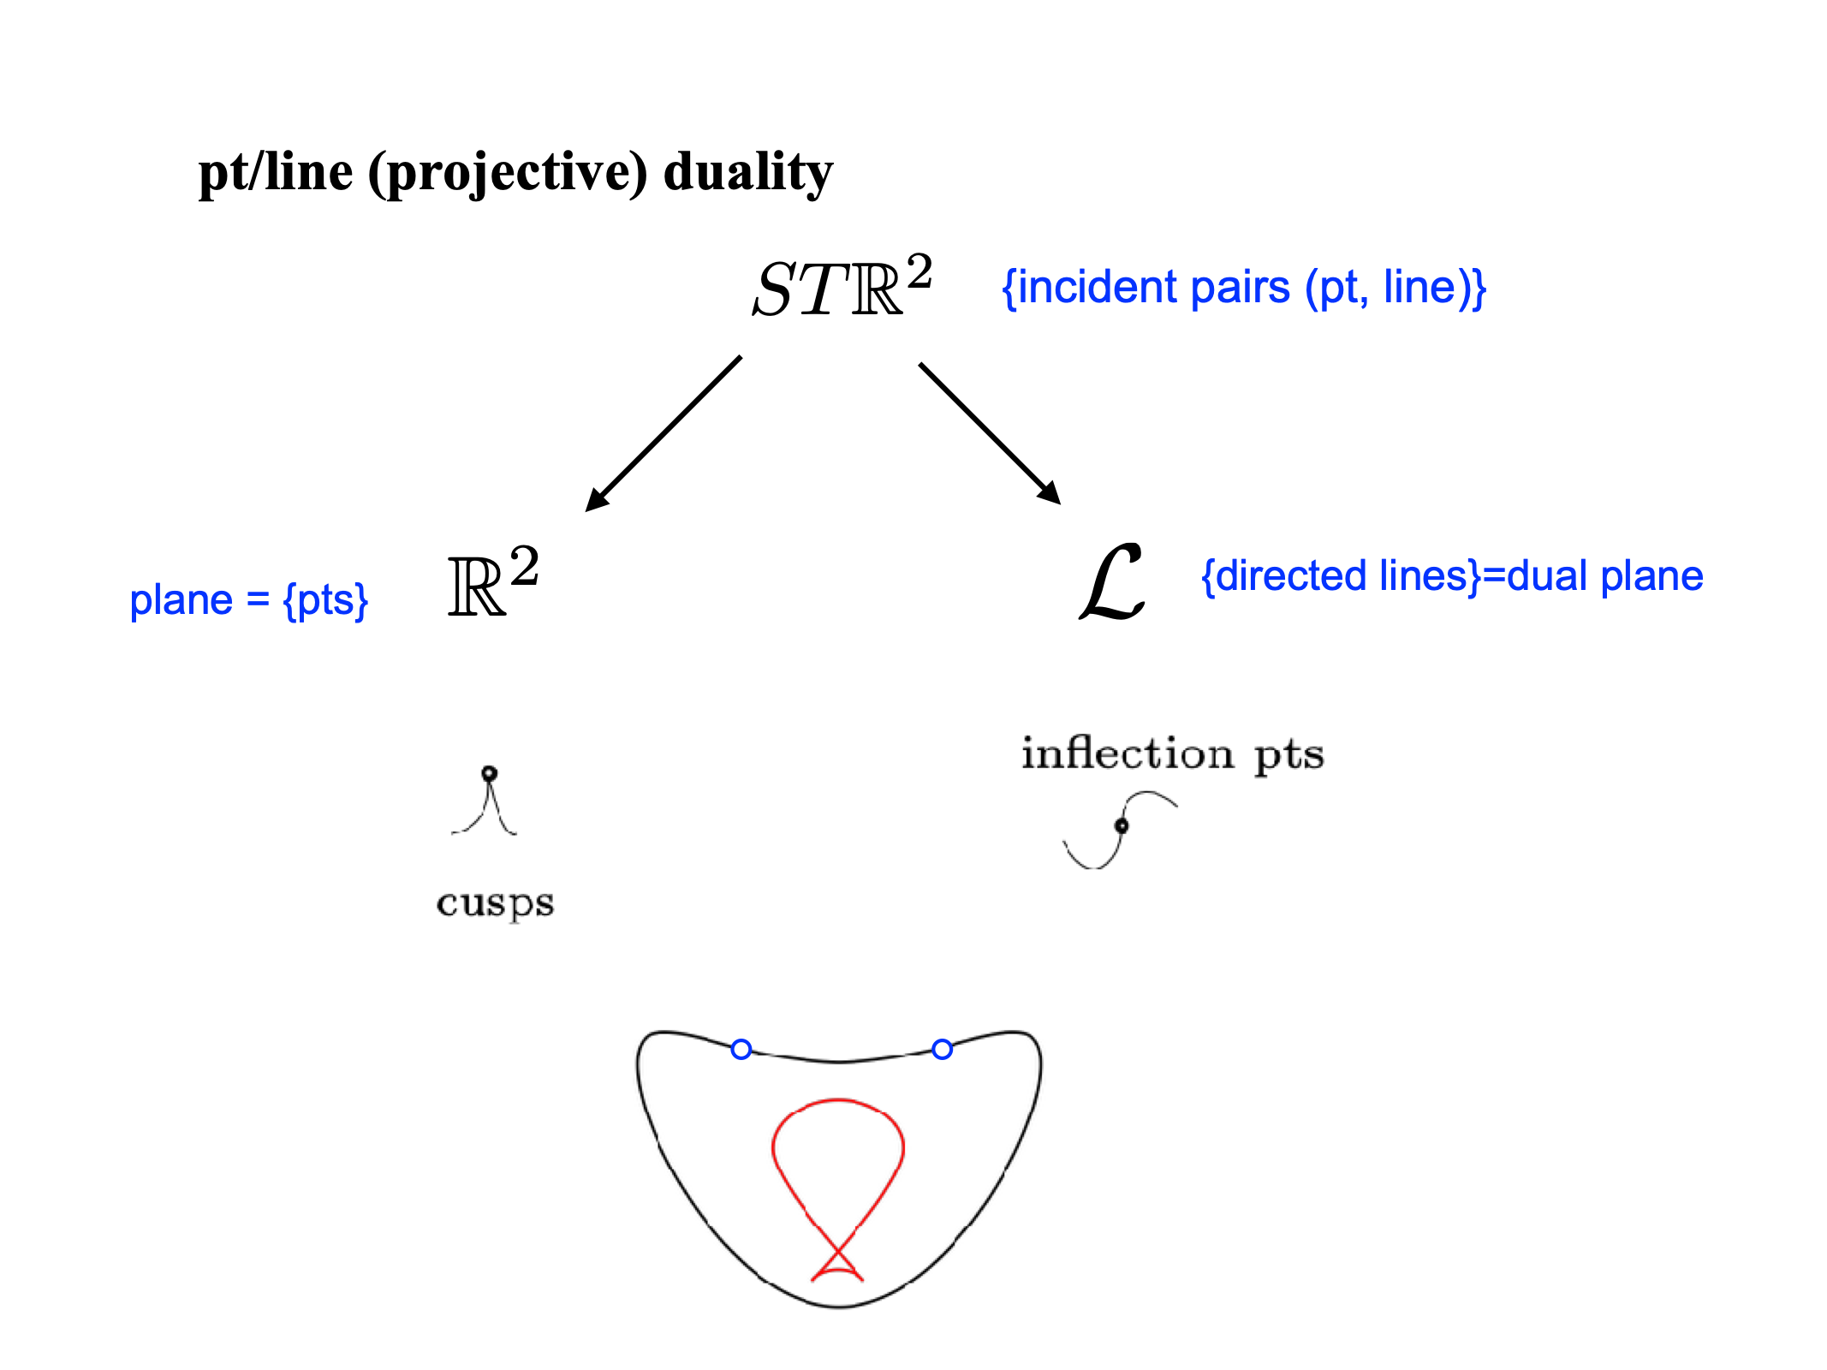

Slide 21
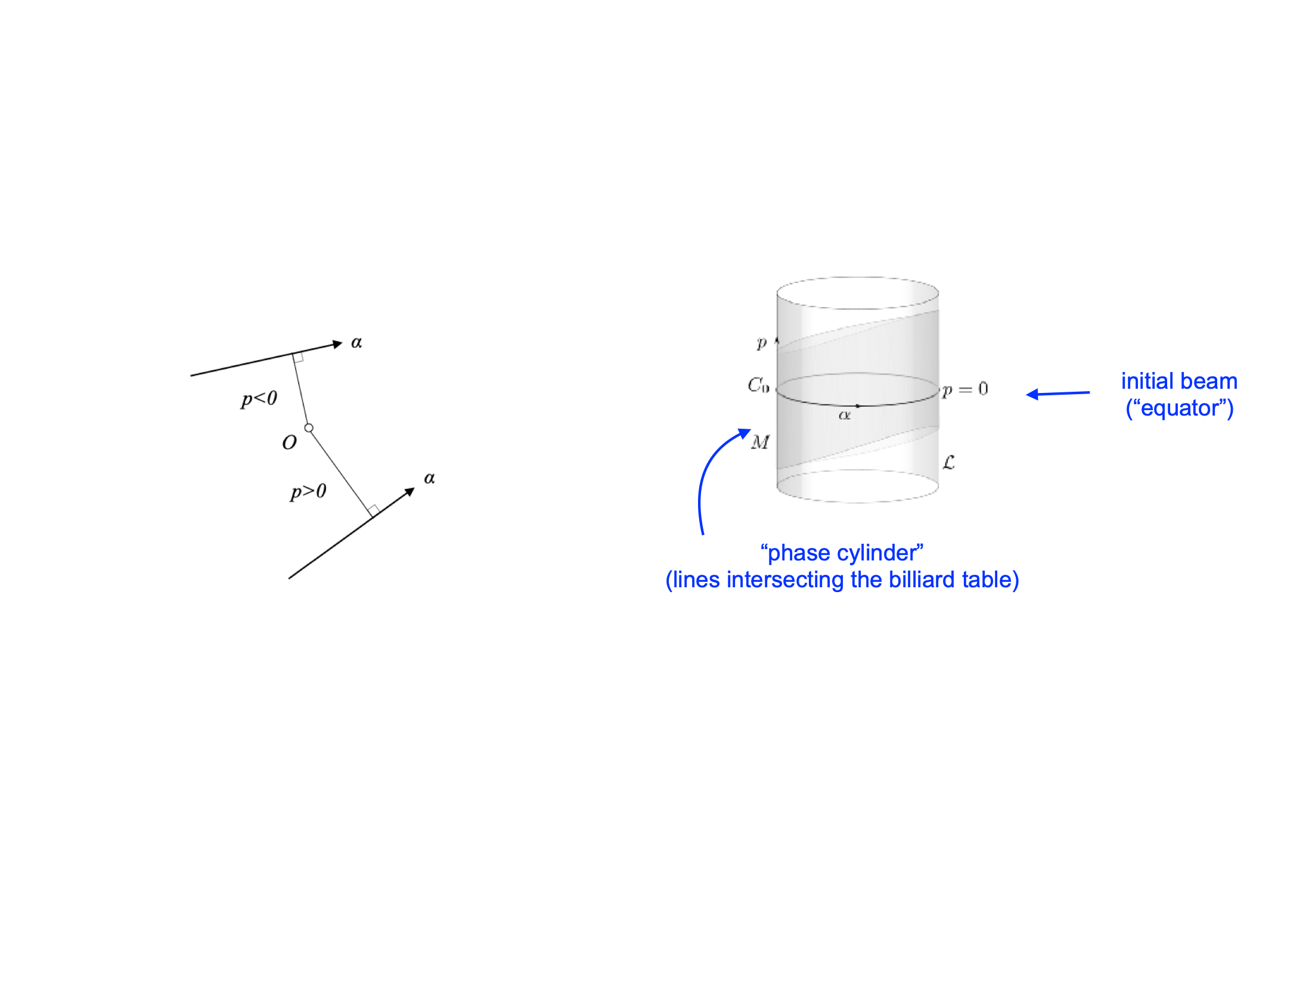

Slide 26
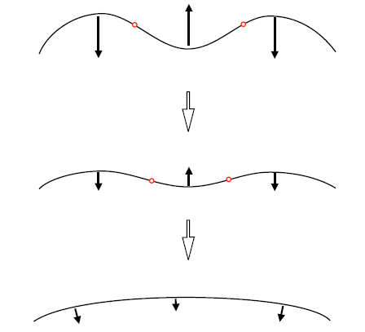
Alternative:
Use a curve shortening flow argument
Num of inflection pts descreases
Curve flows into the equator
Near the equator the curve is a graph of a function $f$ with $∫f=0.$
Inflection pts are zeros of $g=f^{′′}+f$
$g$ has vanishing 0th and 1st harmonics $⟹ ≥4$ zeros (Sturm-Hurwitz thm)

Slide 27
Thanks!
Merci!!

